Slide 1
UPDATE YOUR RESUME AND COVER LETTER
MSVU Career Services Kyla Friel, Career Counsellor September 13, 2024

Slide 2
halifaxcareerfair.ca/student-registration

Slide 3
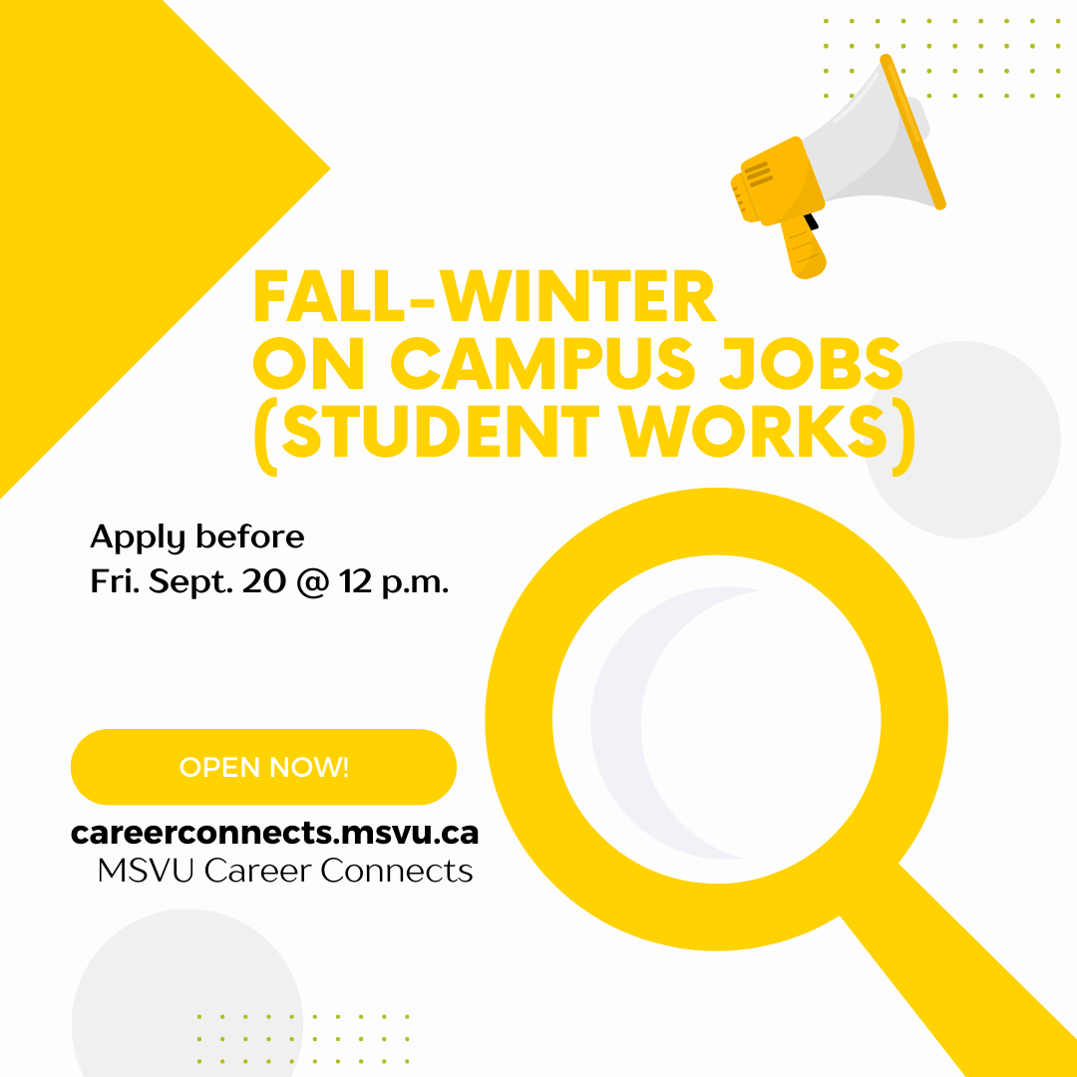
APPLY NOW for student works!
Part-time on campus work from October 2024 to March 2025 at 12 hours per week, $17 per hour + fringe
Check to see if you're eligible
Apply on MSVU Career Connects
*In-person drop-in Thurs. Sept. 19 from 1 p.m. to 2:30 p.m., McCain Atrium

Slide 4
WHAT WE'LL look AT TODAY
Resumes: goals and types
Sections: what to cover?
Cover letter structure
Contact Career Services
POLL: True or false?: It's good to include 3 or 4 keywords from the job posting in your resume.

Slide 5
Goal #1: Getting work fast
Use a combination-style resume to focus on your skills, then work experience
Update your skills section and work experience section according to the job posting (and accurate to your lived experience)
Use a mini sentence for your skills section (more to come on this)
POLL: Does volunteer experience hold the same weight as work experience for employers?
COMBINATION-STYLE RESUME (Use these sections over one or two pages)
Name Profile* Education Skills Work Experience Volunteer Experience Professional Development* Certifications and Training* Awards* Interests* *Optional/as needed

Slide 6
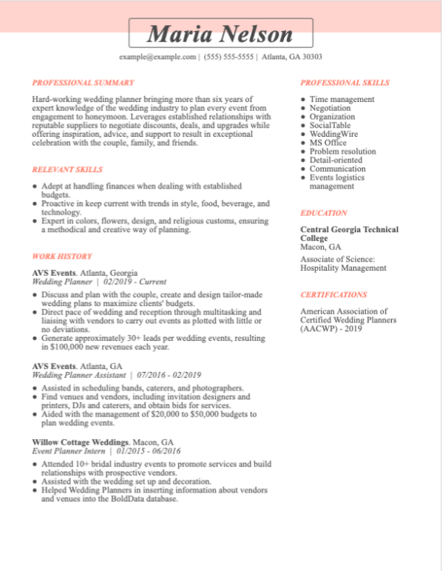
Profile
List of skills
Skills
Education should go underneath your profile
Work Experience
Source https://www.jobhero.com/career-guides/resume/formats/hybrid

Slide 7
Goal #2: BUILDING FROM LOW EXPERIENCE
Functional resumes work when you're just starting to get work experience, you're making a complete career/program change, your work history is all over the place, or you don't have recent experience
Identify three overarching skills (Skill 1, Skill 2...) and 'pull apart' your traditional work experience section, inserting the bullet points into the overarching skills
Great for applying to a 'convenient' job that you may feel overqualified for
POLL: What skills are good for any job?
FUNCTIONAL-STYLE RESUME (Use these sections over one or two pages)
Name Profile Education Skill Summary Skill 1 (with bulleted list) Skill 2 (with bulleted list) Skill 3 (with bulleted list) Work Experience (list of titles/orgs. & dates only) Volunteer Experience Professional Development* Certifications and Training* Awards* Interests* *Optional/as needed

Slide 8
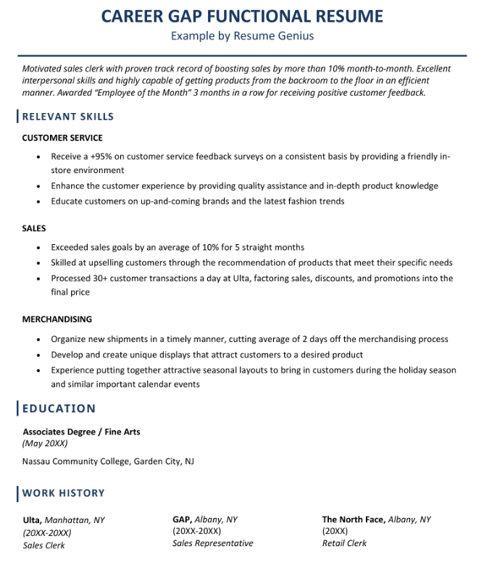
Profile
Source: https://resumegenius.com/blog/resume-help/functional-resume
Skill 1
Skill 2
Skill 3
Education here? It depends!
Work Experience as a list

Slide 9
SECTIONS: WHAT TO COVER?
Whole resume
Most current date first, city, location, title/job title
Consistent formatting: bullet points or short paragraphs
1 or 2 pages
Skills section – the summary Frame your overall experience with qualifiers, statistics, numbers, themes, types, or time frame
Served at private parties, weddings, and corporate events of up to 500 people
Experience building Instagram campaigns and analytics reports for well-known community organizations
Combined two years' experience in front desk reception and database management

Slide 10
SECTIONS: WHAT TO COVER?
Work experience section Use accomplishment statements to make your work stand out (more specific than your skills section) Action verb + challenge + result
Worked as a team to deliver 5-course plated meals during the IWK Health Sciences Fundraiser for Kids , coordinating with the event planner to ensure timing with keynote addresses and fundraising efforts.
Developed Instagram content, a posting schedule, and guidelines for interpreting analytics in a way that was user-friendly for the organization. Previously, the organization had expressed an interest in starting an Instagram- account but was unsure how to proceed.
Used the Hotel Guest online platform and point-of-sale technology to ensure speedy guest check-in and check-out.

Slide 11
Cover letter structure
Paragraph 1 – The top 3 things to know about you or what you can contribute. Consider using an elevator pitch
Paragraph 2 – STAR technique to show how you problem solve (explain a Situation, the Task that needed to be done, the Action you took, and the Result). This is actually the paragraph version of an accomplishment statement
Paragraph 3 – Values, goals, what you can offer or something that connects you to the job posting or organization OR another STAR technique
Paragraph 4 – Closing
Use the MSVU Career Services Resume and Cover Letter Handbook
Name Company name, address Job reference number Date Dear Hiring Manager,/Dear Hiring Team Paragraph 1 Paragraph 2 Paragraph 3 Paragraph 4 – closing Sincerely, Your name

Slide 12
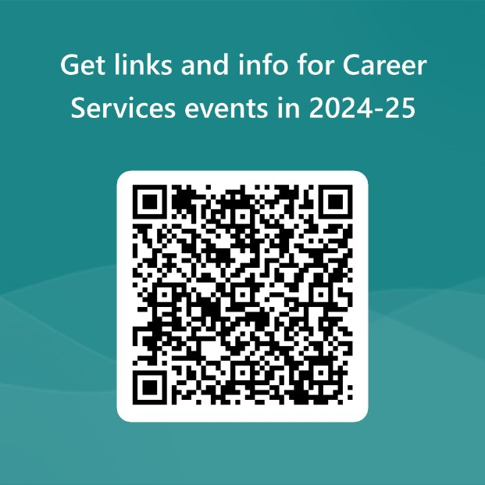
Contact career services
Career counselling virtual or in-person counselling@msvu.ca 902-457-6567
msvu.ca/careerplanning
Resume and cover letter feedback Career indecision Job search support Interview preparation Graduate school/internship applications
Halifax Universities Career Fair Oct. 23 halifaxcareerfair.ca/student-registration

